Slide 1




14 - 16 NOVEMBER 2023
RIYADH, SAUDI ARABIA
ATTACKING DNS RESOLVERS FROM THE SERVER-SIDE FOR FUN AND PROFIT
IVAN JEDEK
ORGANISED BY:
IN ASSOCIATION WITH:

Slide 2

AGENDA
DNS servers 101
Strategies for pentesting a DNS resolver
Introducing for server-to-server attack scenarios
usage examples and real-world applications
Conclusion

Slide 3

IVAN JEDEK
Senior Security Researcher at OryxLabs Technologies (UAE)
Past:
RED : Penetration tester / red teamer / consultant
BLUE : Malware analyst / reverse engineer (asm/x86)
OSCP, OSCE
www.infosecmatter.com
github.com/InfosecMatter

Slide 4

BRACE YOURSELVES
TECHNICALITIES ARE COMING

Slide 5
WHY DNS RESOLVERS?

Slide 6
WHY DNS RESOLVERS?
We all use them all the time to locate internet hosts
DNS is a critical network component
Lack of infosec coverage (opportunities)
High potential to find new vulnerabilities
Bug bounty programs (Cloudflare, Quad9, OpenDNS, PowerDNS..)
It’s fun!

Slide 7

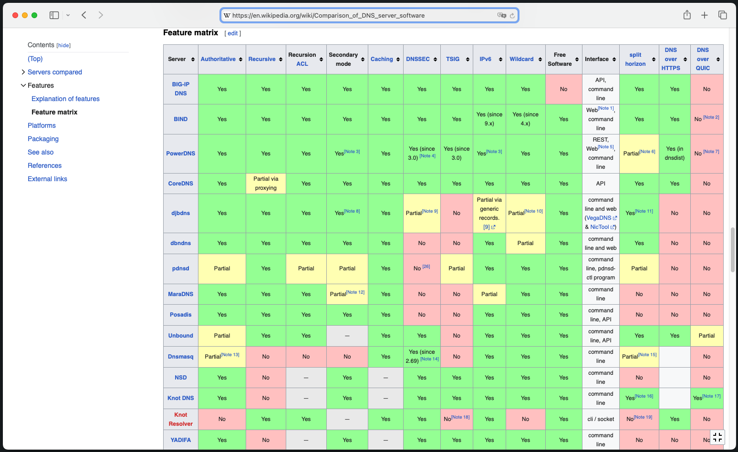
https://en.wikipedia.org/wiki/Comparison_of_DNS_server_software

Slide 8
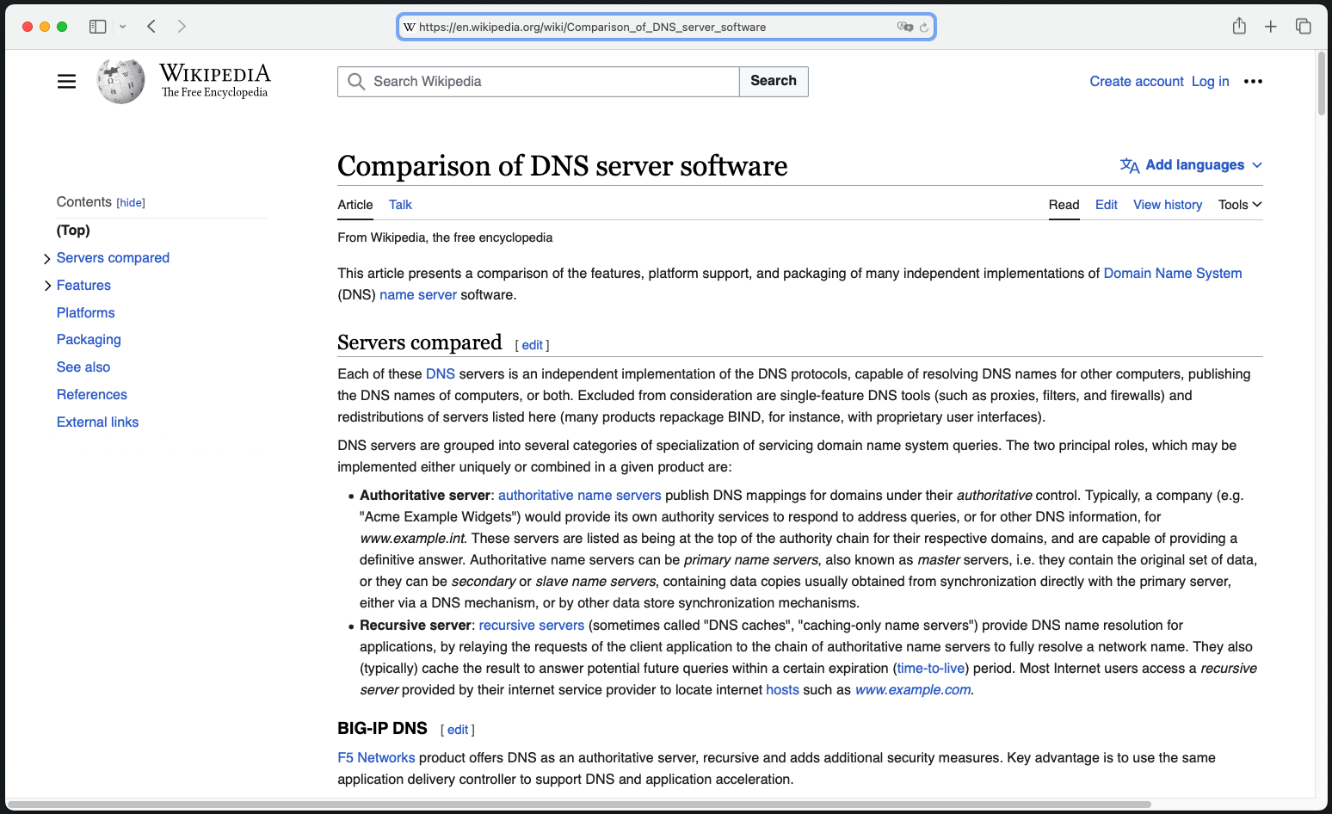
https://en.wikipedia.org/wiki/Comparison_of_DNS_server_software

Slide 9
https://en.wikipedia.org/wiki/Comparison_of_DNS_server_software

Slide 10
https://en.wikipedia.org/wiki/Comparison_of_DNS_server_software

Slide 11
https://en.wikipedia.org/wiki/Comparison_of_DNS_server_software

Slide 12
RECURSIVE DNS RESOLVERS
Public DNS resolvers (Google, Cloudflare, Quad9, OpenDNS ..)
DNS server of your ISP, your employer, school, coffee shop ..
DNS server running in your network e.g., your home network router
DNS resolver running on your system (systemd-resolved ..)
Any custom-built DNS resolver
OUR TARGETS

Slide 13

TYPICAL DNS COMMUNICATION
What is the IP of www.example.com ?
example.com
2.
DNS resolver
Authoritative DNS server
NS1
www.example.com has IP of 1.2.3.4
3.
Authoritative DNS server
NS2
What is the IP of www.example.com ?
OUR TARGET
1.
4.
www.example.com has IP of 1.2.3.4
MISSION OBJECTIVE:
Conduct a PENETRATION TEST of the TARGET
Client

Slide 14
HOW DO YOU PENTEST A DNS RESOLVER?

Slide 15



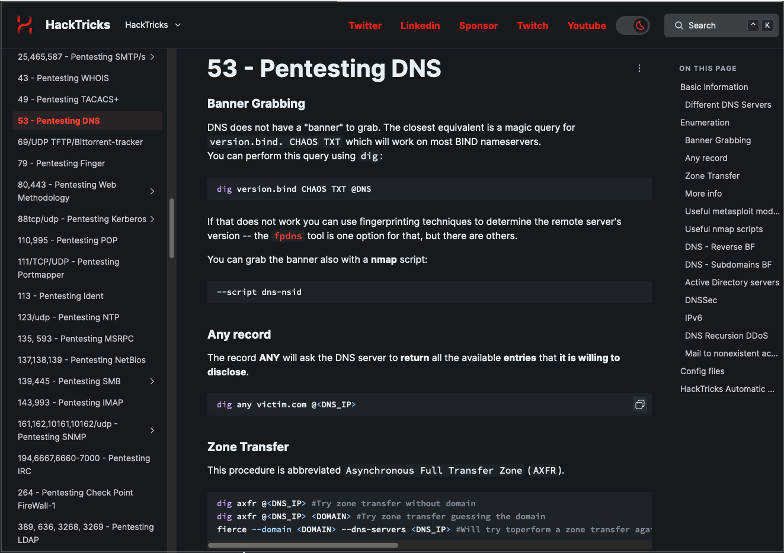
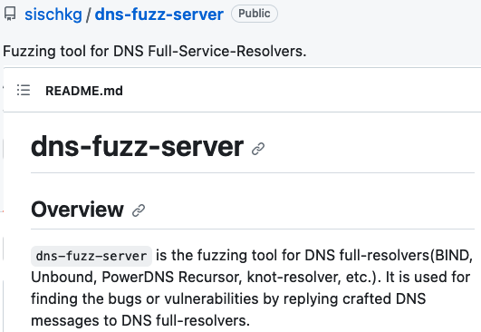
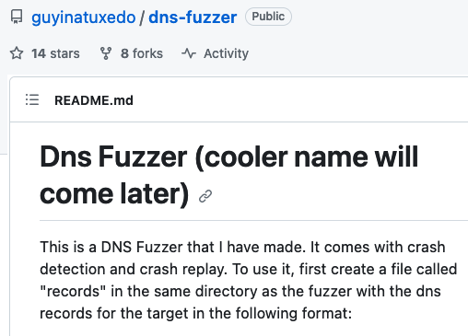
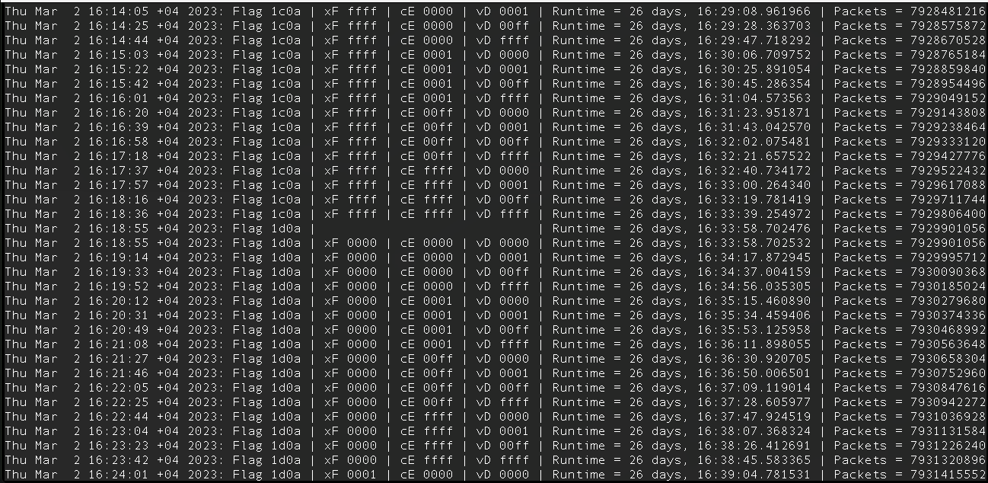


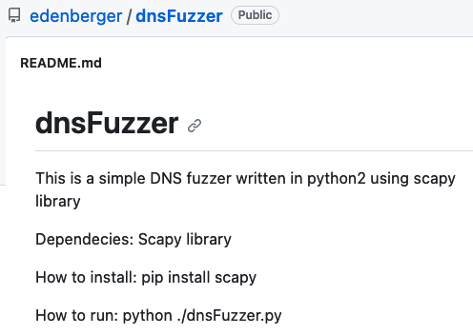
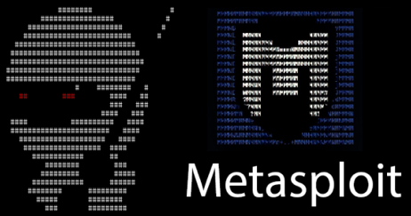
PENTESTING A DNS RESOLVER

Slide 16
PENTESTING A DNS RESOLVER
DNS resolver
Client

Slide 17

PENTESTING A DNS RESOLVER
DNS resolver
Is this enough?
No!
Client-to-Server
SME

Slide 18
PENTESTING A DNS RESOLVER
DNS resolver
DNS test server
Server-to-Server
Is this enough?
No!
We need to test it also from the server-side!
We need a special setup!
We need a special DNS server for pentesting!
Client-to-Server
SME

Slide 19
ATTACKING FROM THE SERVER-SIDE

Slide 20
SERVER-TO-SERVER APPROACH
attacker.com
DNS resolver
NS1
NS2
Requirements for server-side attack scenarios:
Purchase a domain
Get 2 VPS instances with public IPs (static)
Install PolarDNS server on both instances
In the domain registrar, delegate the domain to your nameservers
SME

Slide 21
SERVER-TO-SERVER APPROACH
What is the IP of www.attacker.com ?
attacker.com
2.
DNS resolver
NS1
B A D
3.
?
NS2
What is the IP of www.attacker.com ?
1.
4.
Requirements for server-side attack scenarios:
Purchase a domain
Get 2 VPS instances with public IPs (static)
Install PolarDNS server on both instances
In the domain registrar, delegate the domain to your nameservers
?
SME

Slide 22
INTRODUCING

Slide 23
A specialized authoritative DNS server developed by OryxLabs specifically designed for penetration testing and vulnerability research
Gives the operator full control over the DNS protocol layer
Supports both UDP and TCP modes of operation
It can generate custom DNS responses, including non-compliant, abnormal and even heavily malformed DNS responses

Slide 24
– KEY CONCEPT
By asking the PolarDNS server to resolve something, you are essentially giving it instructions how it should respond to you
You, as a client, dictate the PolarDNS server what kind of response it should produce for you
Very useful and convenient for testing purposes

Slide 25
– MAIN CAPABILITIES
As an authoritative DNS server, it supports a standard static ZONE
Generative capabilities containing approx. 60 features able to produce various DNS responses, many of which are parametrized
Additional 11 response modifiers which can be loosely combined and used independently on the requested feature
can produce countless variants of different DNS responses

Slide 26
– SYNTAX 101
# dig <FEATURE>.[<PARAMETERS>].[<MODIFIERS>].attacker.com
# dig feature1.attacker.com
# dig feature2.500.1000.mod1.mod2.attacker.com

Slide 27
– REPOSITORY
PolarDNS homepage: https://github.com/OryxLabs/PolarDNS
The tool comes with a catalogue, listing all the features and response modifiers, including:
Description
Format (syntax)
Examples
Sample output

Slide 28
FEATURE EXAMPLES

Slide 29
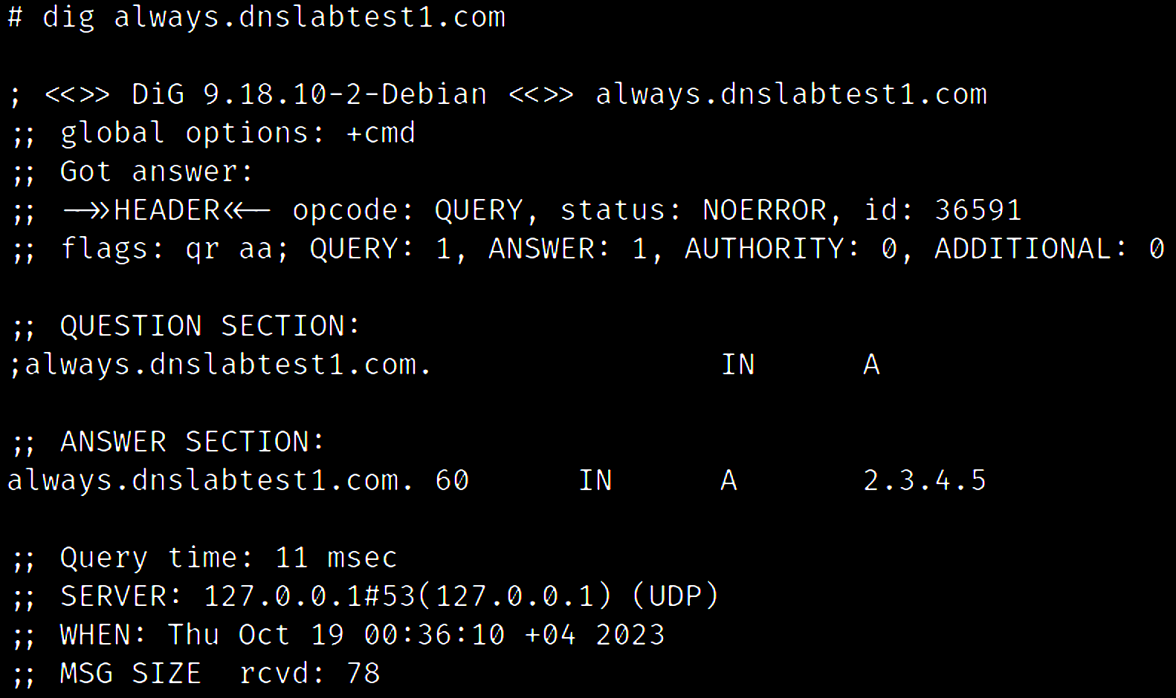
ALWAYS RESOLVE TO IP

Slide 30
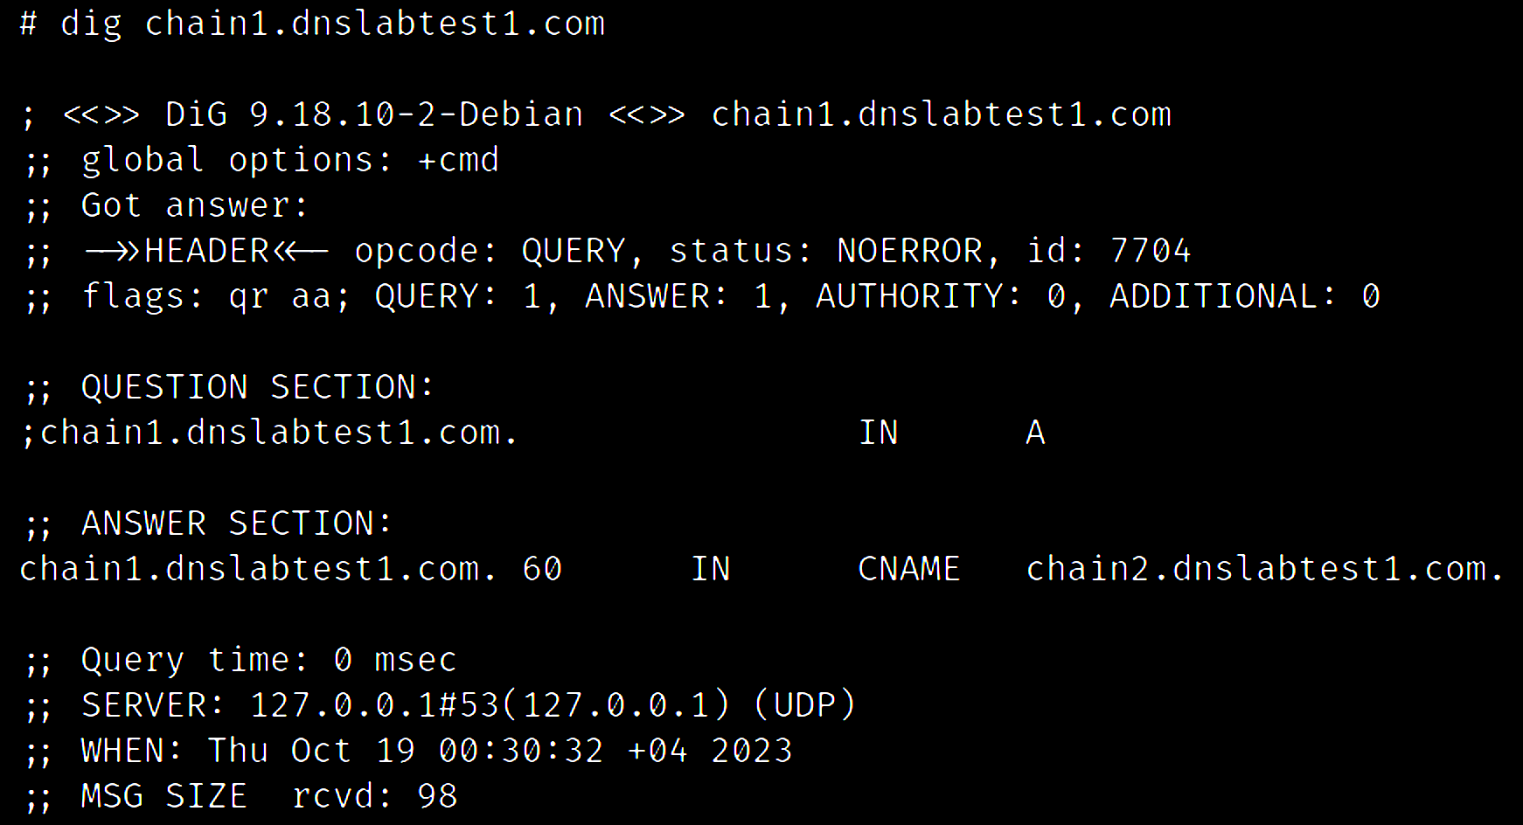
FORM ALIAS CHAINS (CNAME)

Slide 31
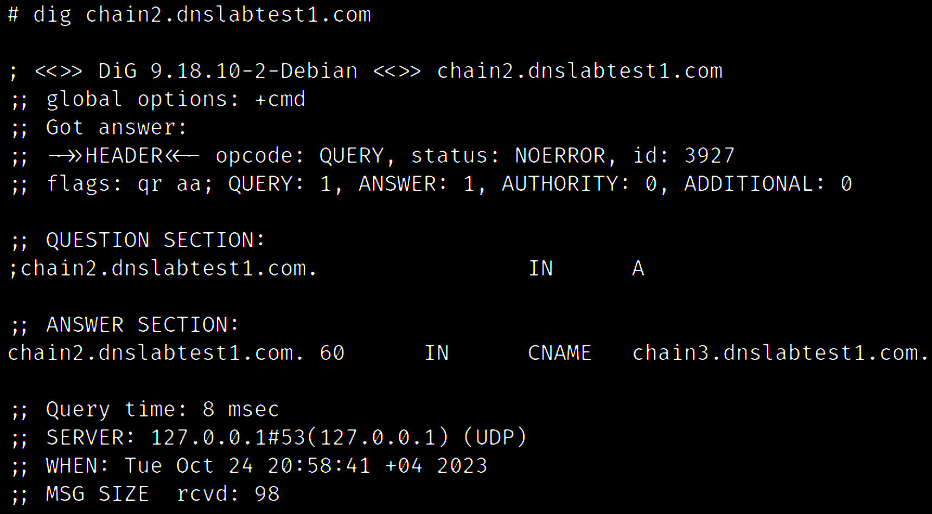
FORM ALIAS CHAINS (CNAME)

Slide 32
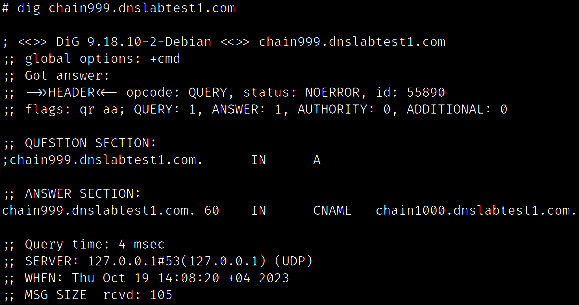
FORM ALIAS CHAINS (CNAME)

Slide 33
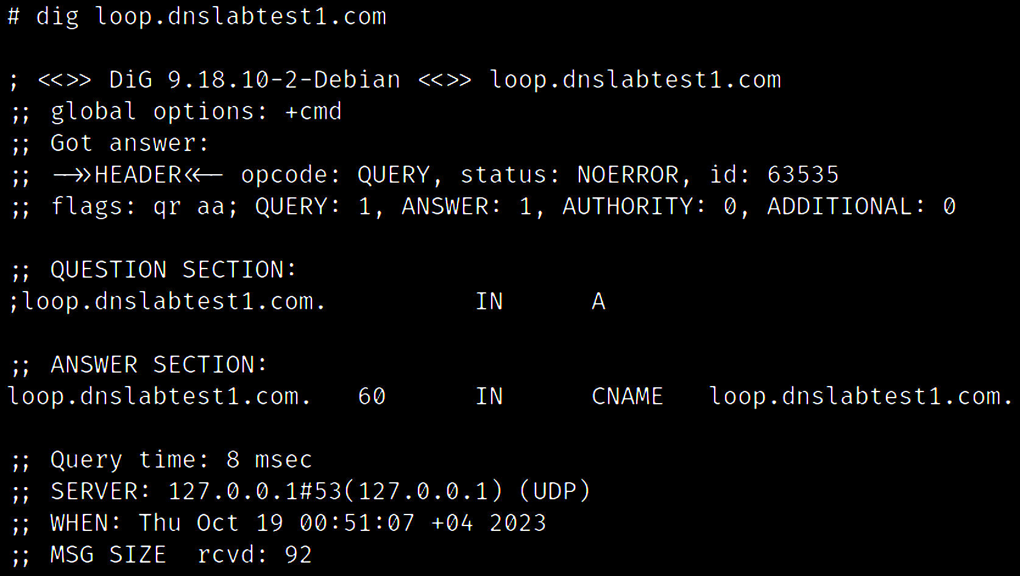
FORM ALIAS LOOPS (CNAME)

Slide 34
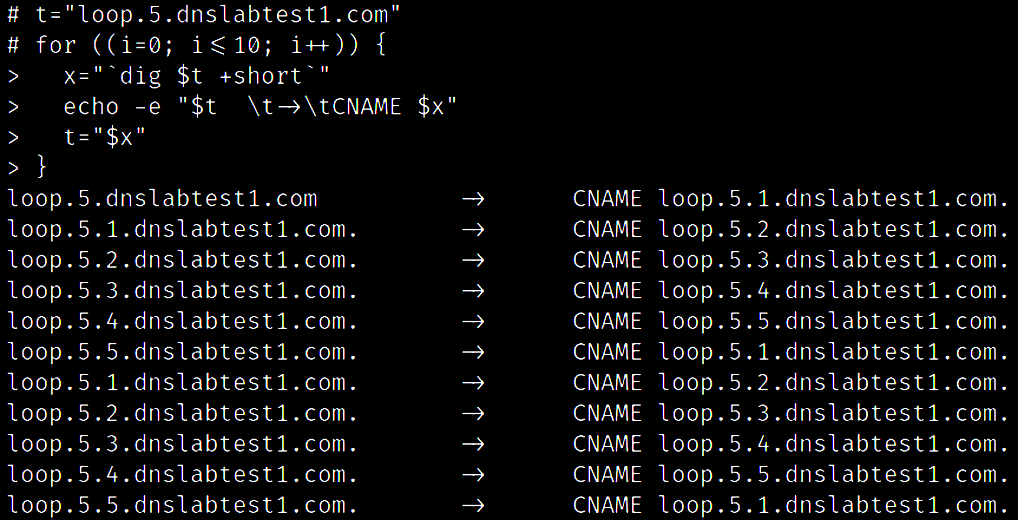
FORM ALIAS LOOPS (CNAME)

Slide 35
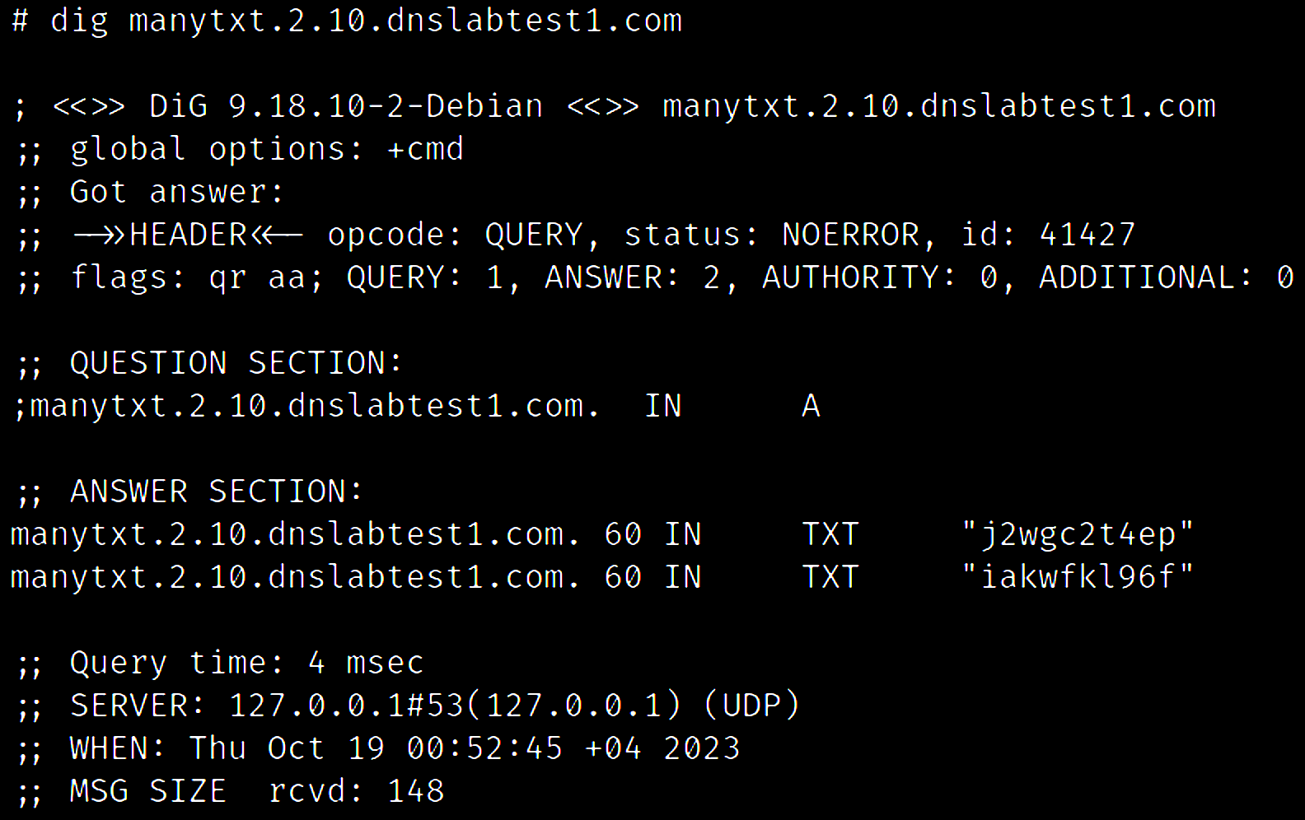
GENERATE RANDOM TXT RECORDS

Slide 36
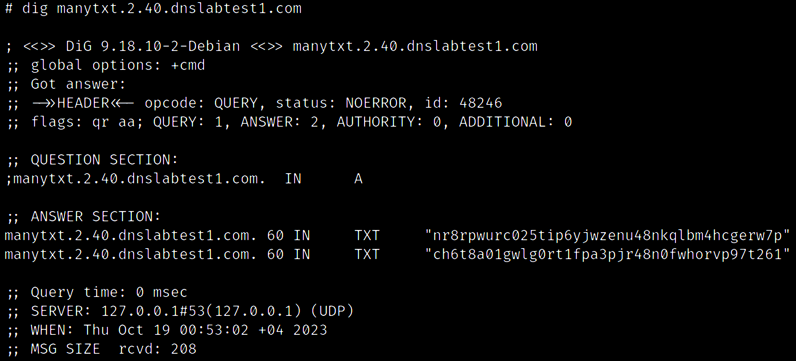
GENERATE RANDOM TXT RECORDS

Slide 37
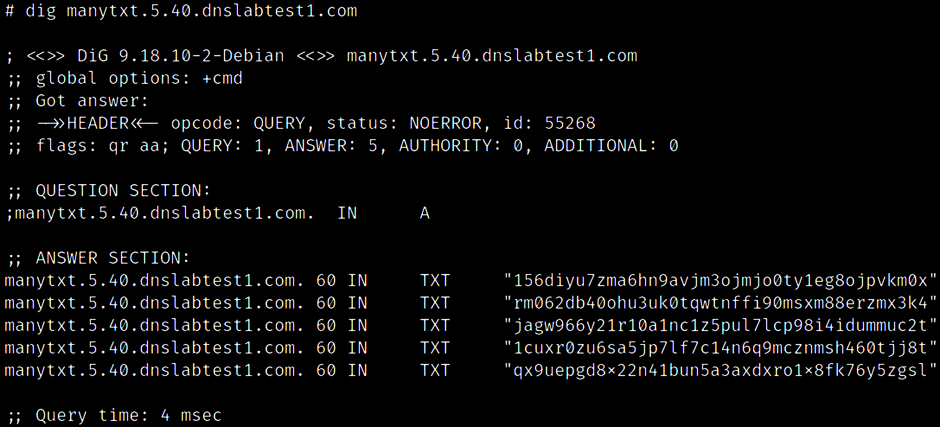
GENERATE RANDOM TXT RECORDS

Slide 38
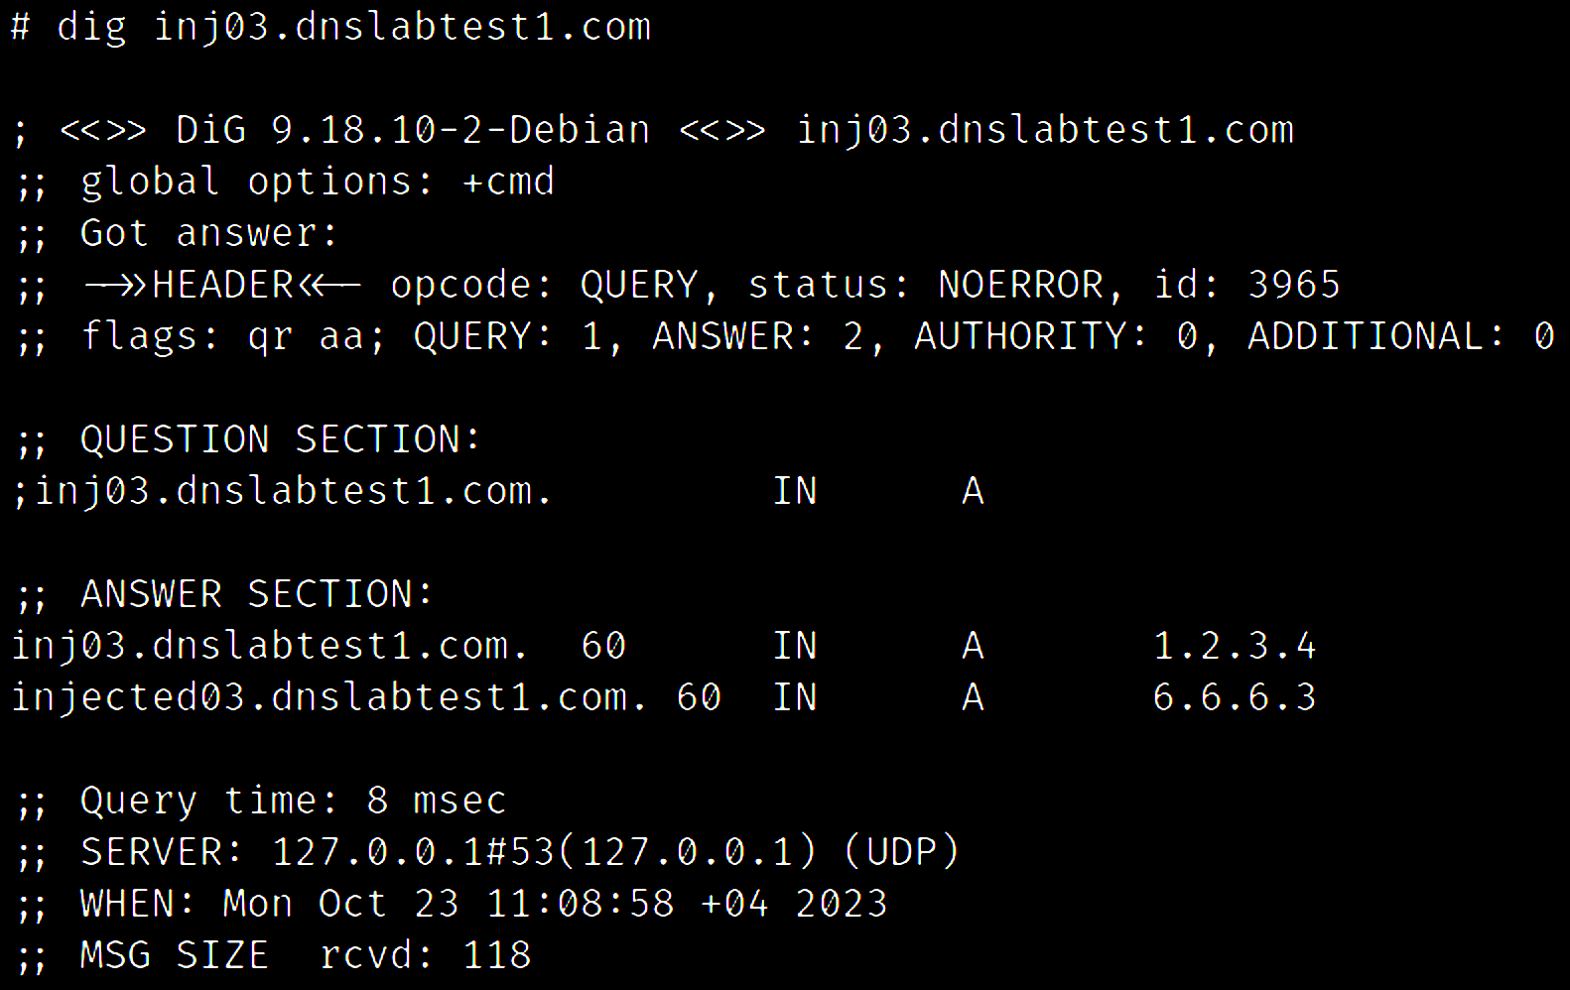
APPEND (INJECT) ARBITRARY RECORDS

Slide 39
APPEND (INJECT) ARBITRARY RECORDS

Slide 40
APPEND (INJECT) ARBITRARY RECORDS
Is the target resolver going to learn the injected information?
Ask if the injected record has been cached:
Unlikely to work, but an important test
14 different injection scenarios in many variants:
Injecting a 3rd party domain information
Replacing the question in the QUERY section
Adding a question in the QUERY section

Slide 41
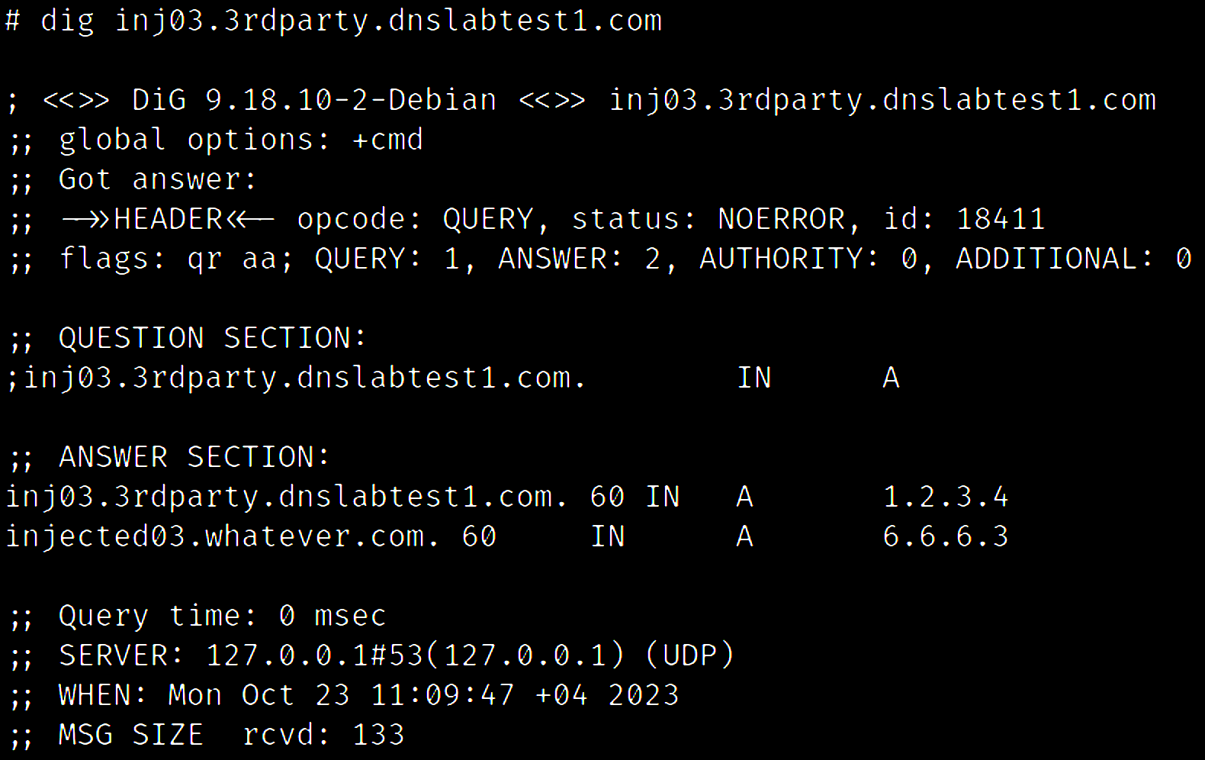
APPEND (INJECT) ARBITRARY RECORDS

Slide 42
APPEND (INJECT) ARBITRARY RECORDS

Slide 43
RESPONSE MODIFIERS

Slide 44
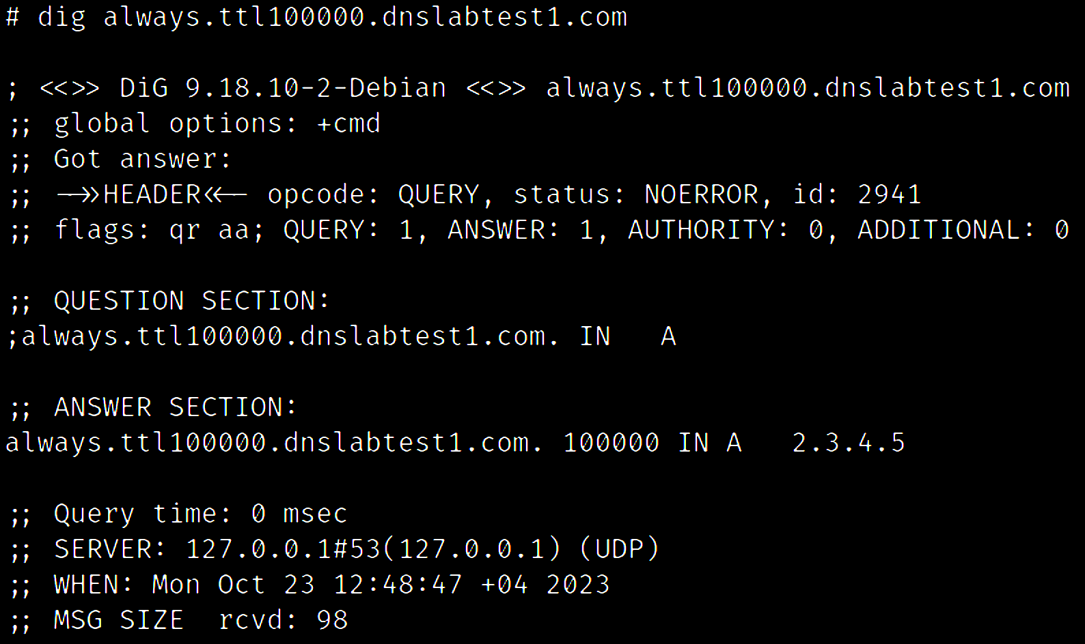
SET ARBITRARY TIME-TO-LIVE (TTL)

Slide 45
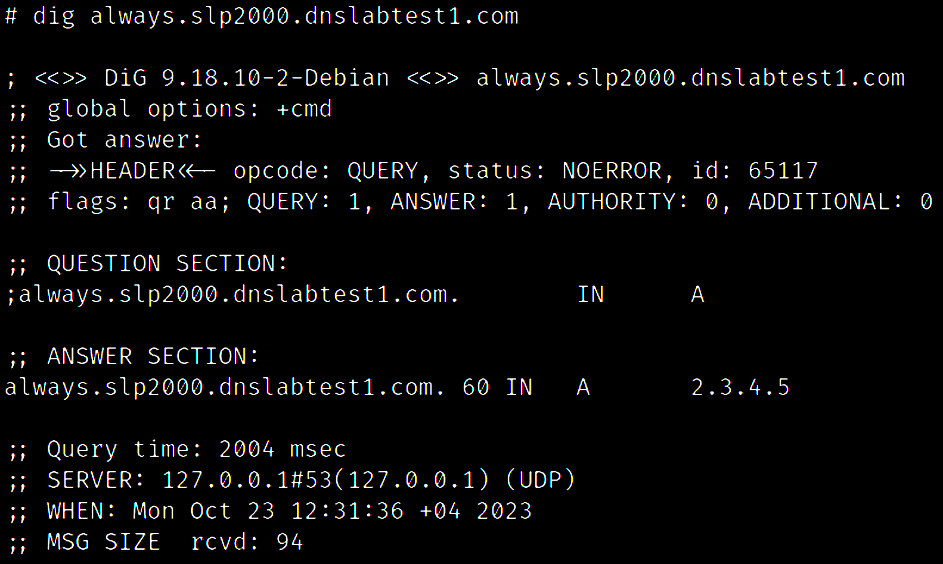
ADD A DELAY / LATENCY

Slide 46
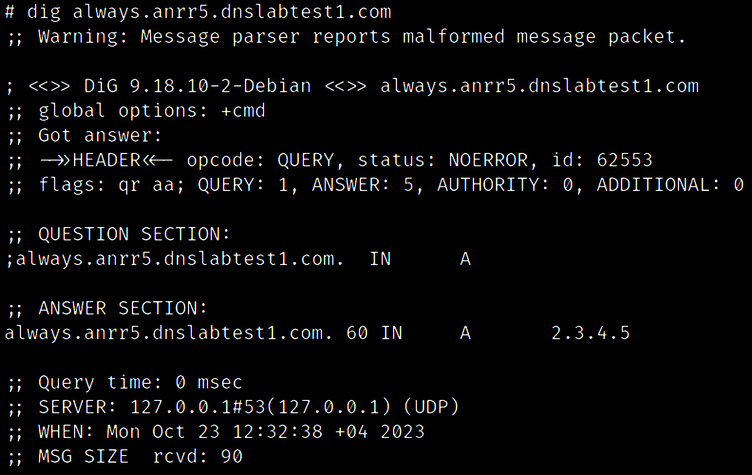
CHANGE NO. OF ANSWERS

Slide 47
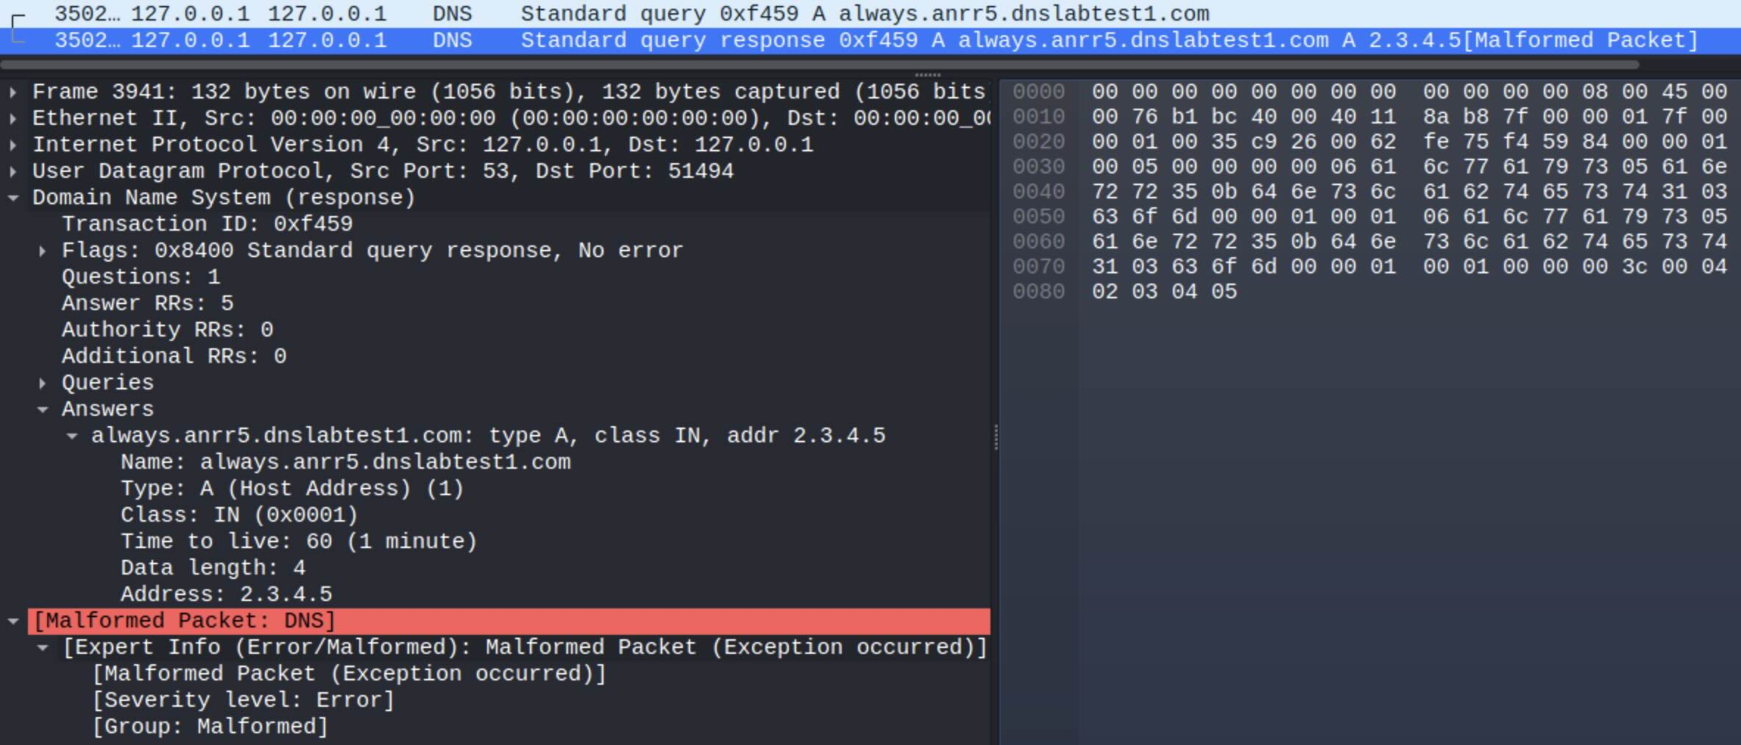
CHANGE NO. OF ANSWERS

Slide 48
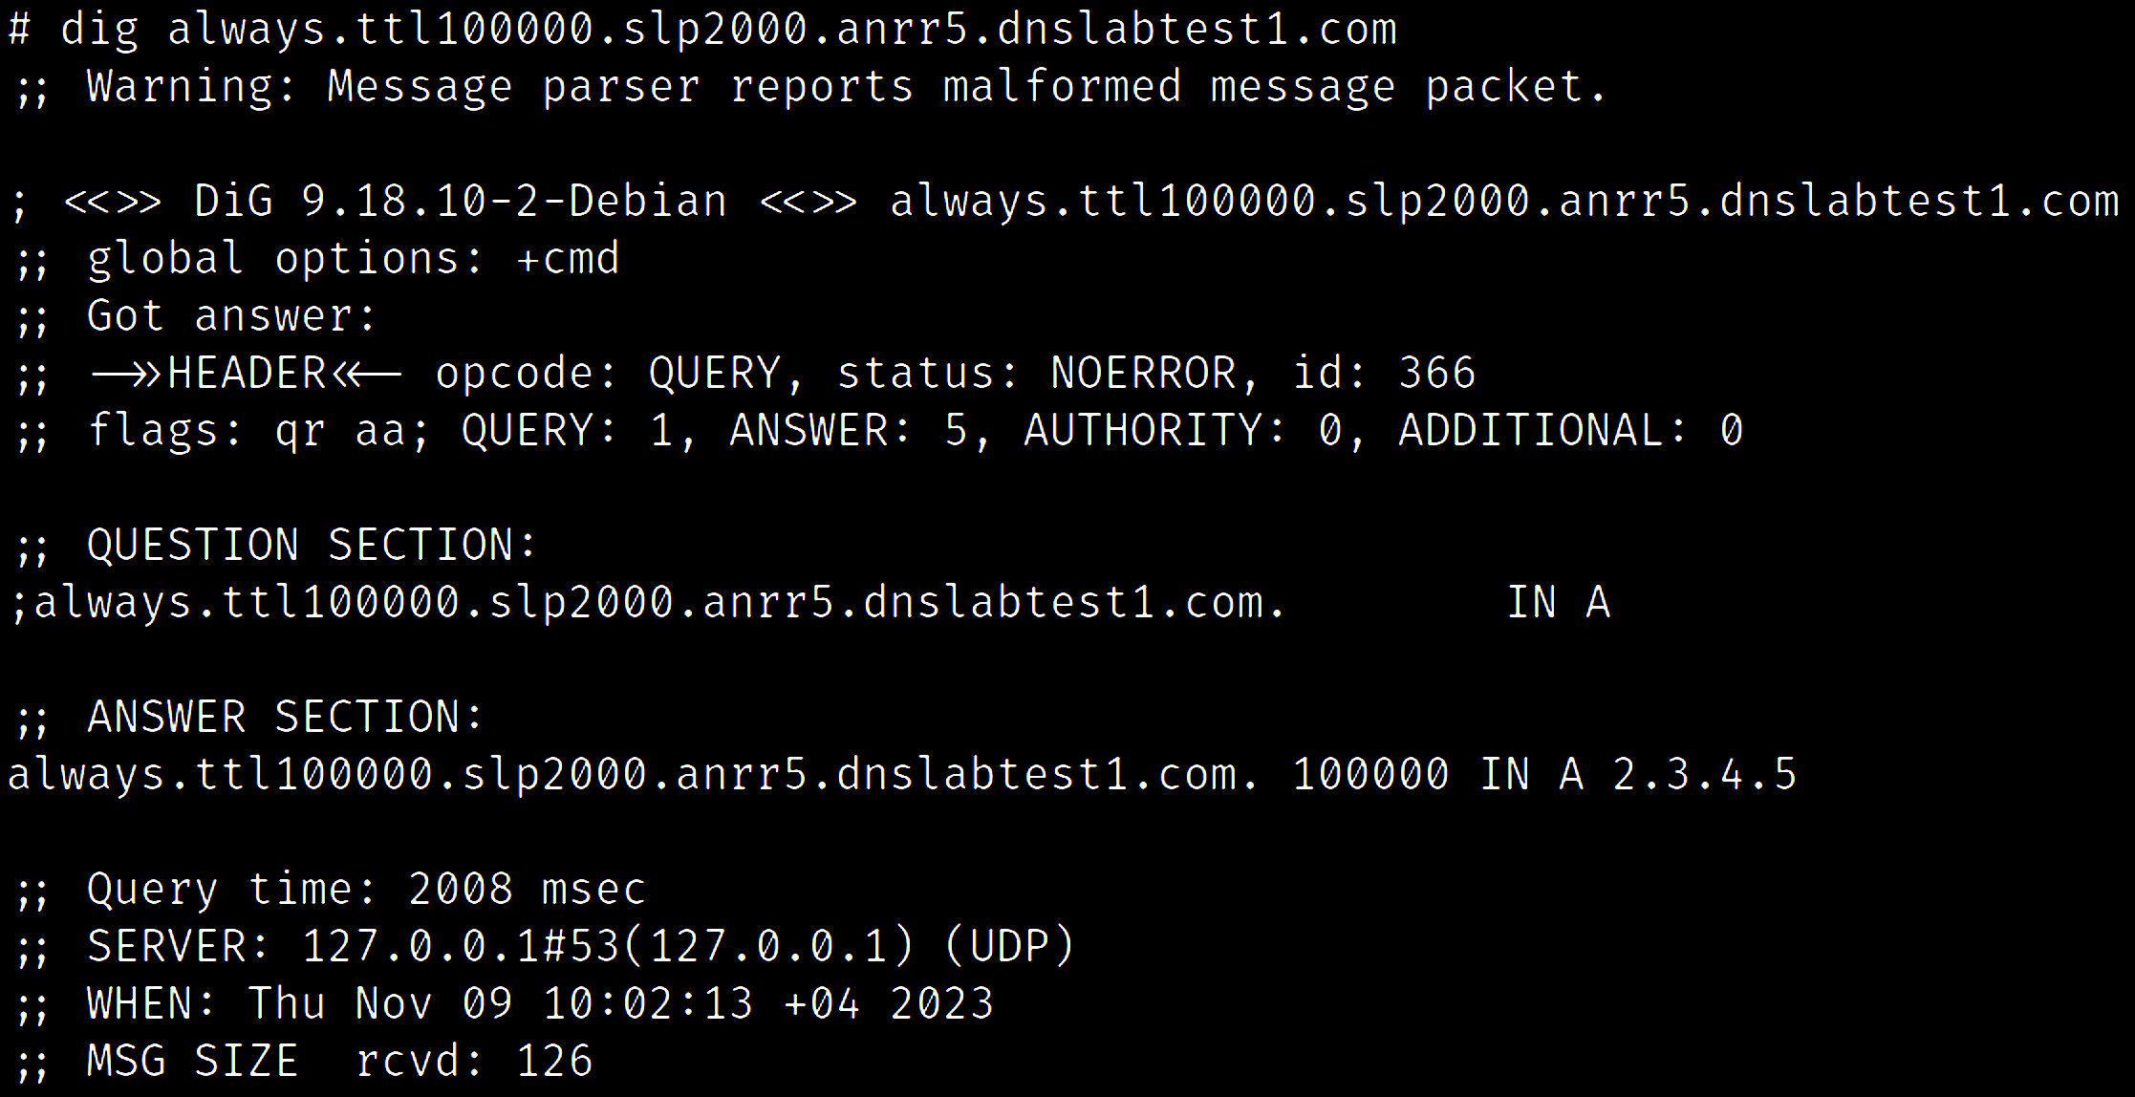
COMBINE MODIFIERS TOGETHER

Slide 49
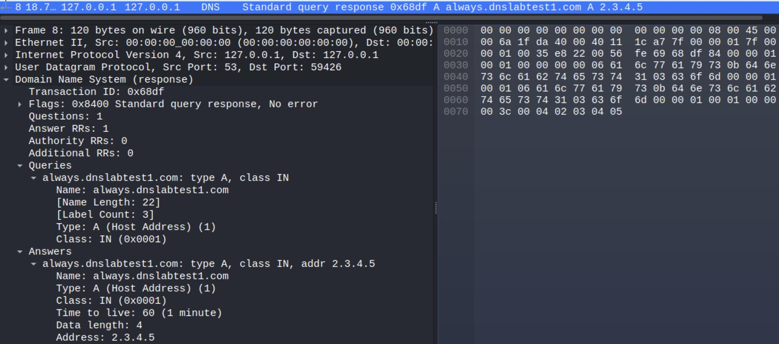
ADDITIONAL MODIFIERS
Response modifiers are:
Universal
Feature-agnostic
Combinable

Slide 50
REAL WORLD APPLICATIONS

Slide 51
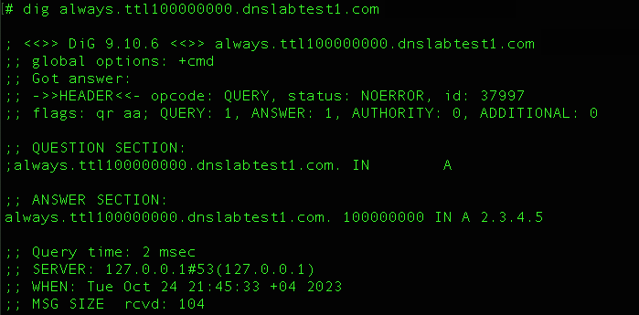
EXORBITANT TIME-TO-LIVE (TTL) VALUES
TTL value of 100,000,000
(3.17 years)

Slide 52
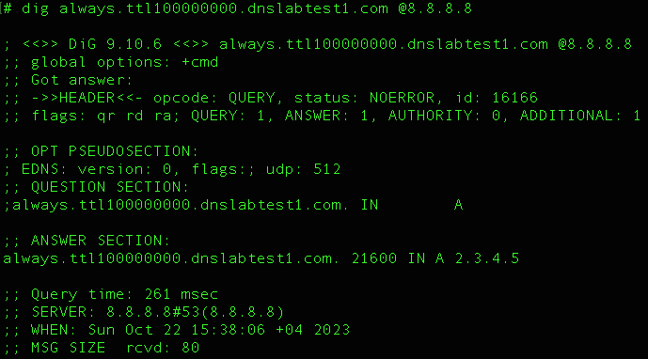
TTL FILTERING – GOOGLE DNS
Google DNS reduced the TTL to 21,600
(6 hours)

Slide 53
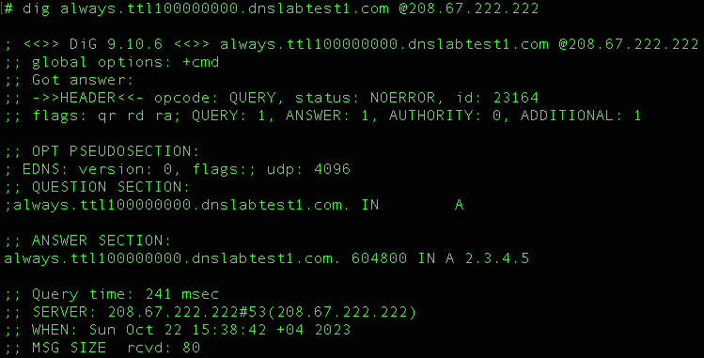
TTL FILTERING – OPENDNS
OpenDNS reduced the TTL to 604,800
(7 days)

Slide 54
TTL FILTERING
Most DNS resolvers filter exorbitant TTL values or at least do not cache such records for a long periods of time

Slide 55
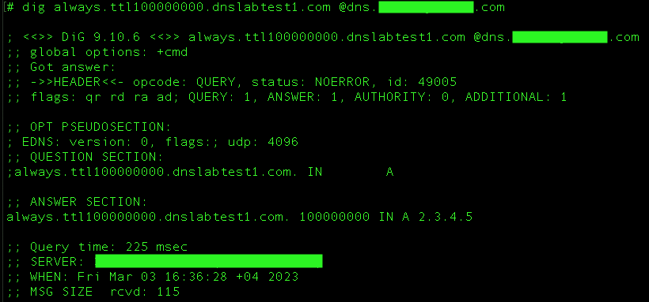
LACK OF TTL FILTERING
-
The TTL in the response is unchanged

Slide 56
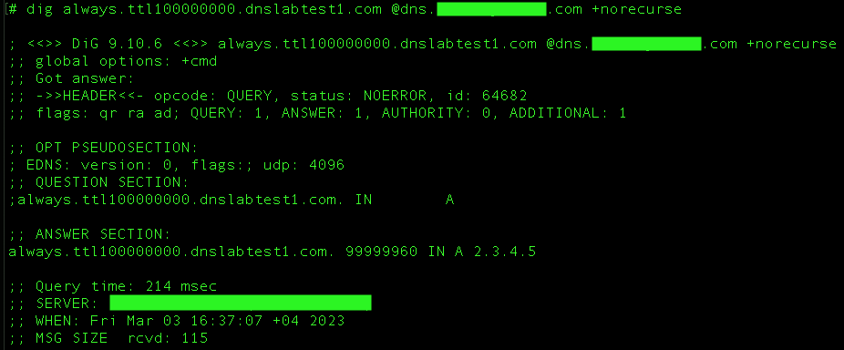
LACK OF TTL FILTERING
Non-recursive query provides proof that the record has been cached

Slide 57
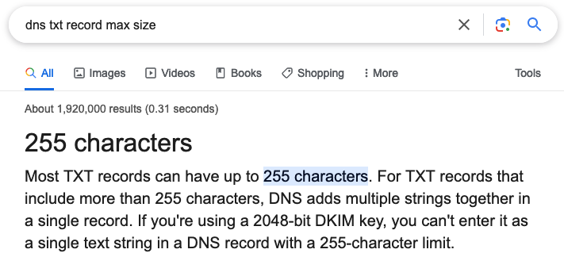
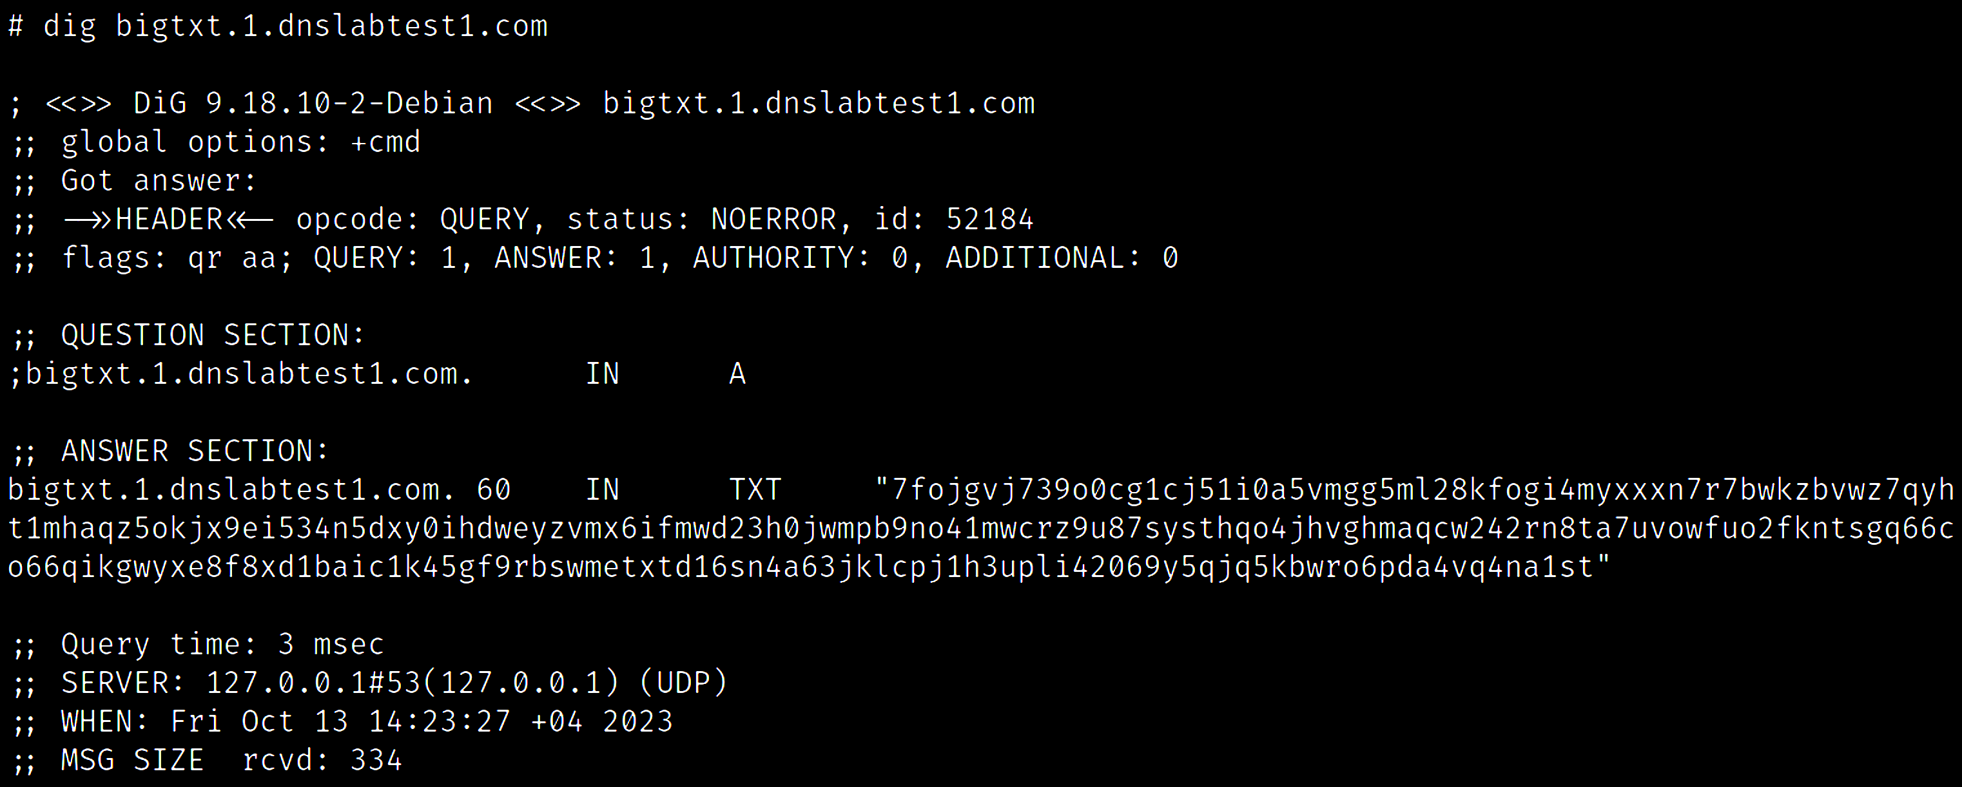
BIG TXT RECORD(S)
255 .

Slide 58
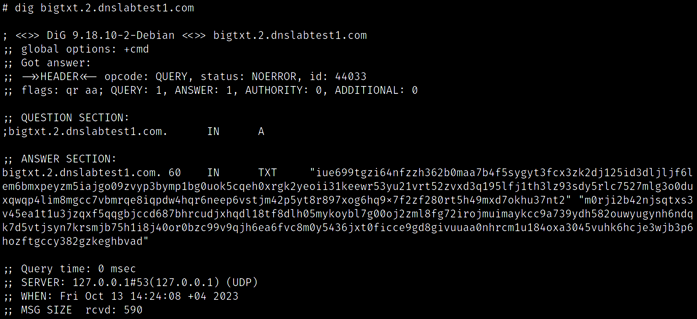
BIG TXT RECORD(S)
255 .
255 .

Slide 59
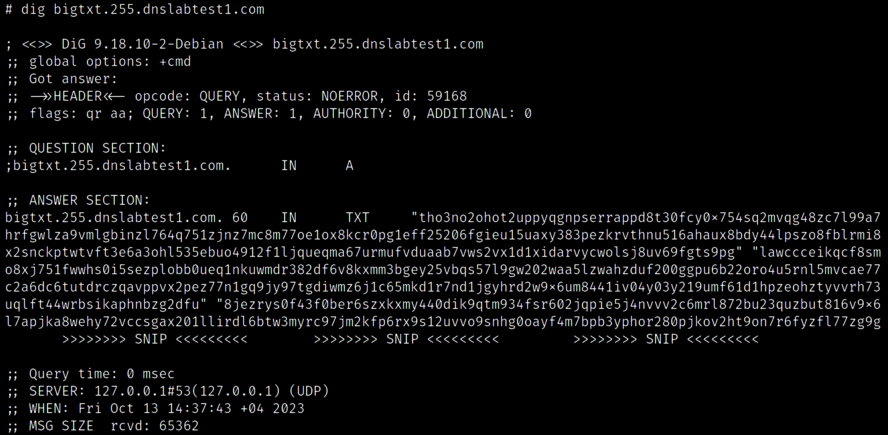
BIG TXT RECORD(S)
255 x 255 .

Slide 60
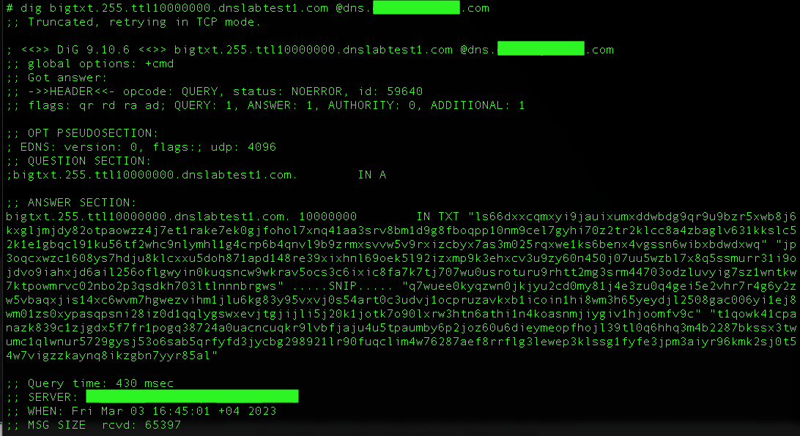
BIG TXT RECORD(S) WITH LARGE TTL
The resolver does not filter records with large TTL
255 x 255 .

Slide 61
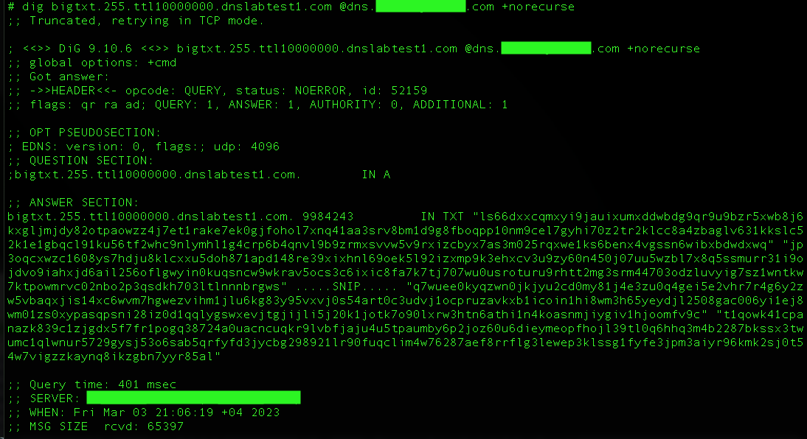
BIG TXT RECORD(S) WITH LARGE TTL
The resolver cached the large TXT record with large TTL
255 x 255 .

Slide 62
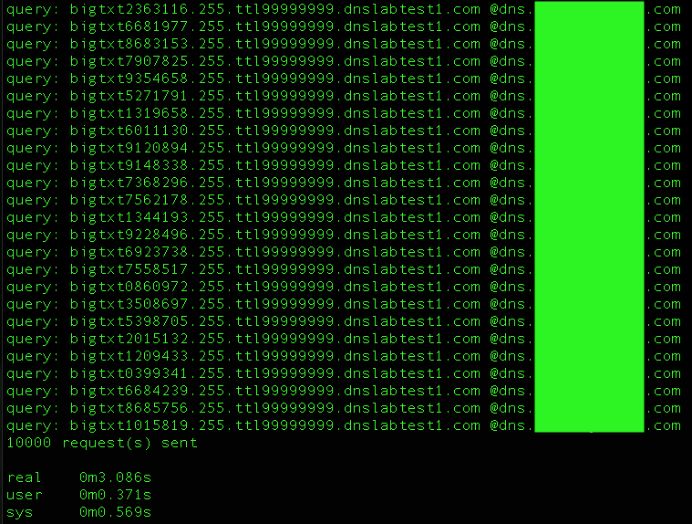
BIG TXT RECORD(S) WITH LARGE TTL
65 KB * 10,000
=
634.76 MB
Scaling out ..
Sending 10,000 queries at once
Cache littering
Could fill up the storage (Potential DoS)

Slide 63

FUN WITH EMPTY RESPONSES
POLARDNS CAN SEND YOU NOTHING
IS THIS GREAT?

Slide 64
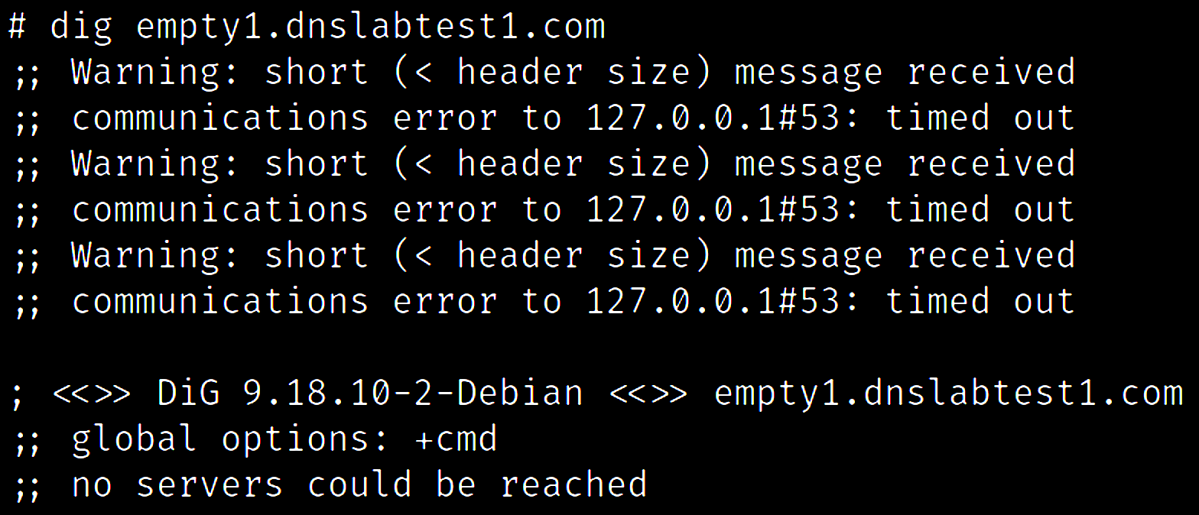
FUN WITH EMPTY RESPONSES
Sending back an empty packet

Slide 65
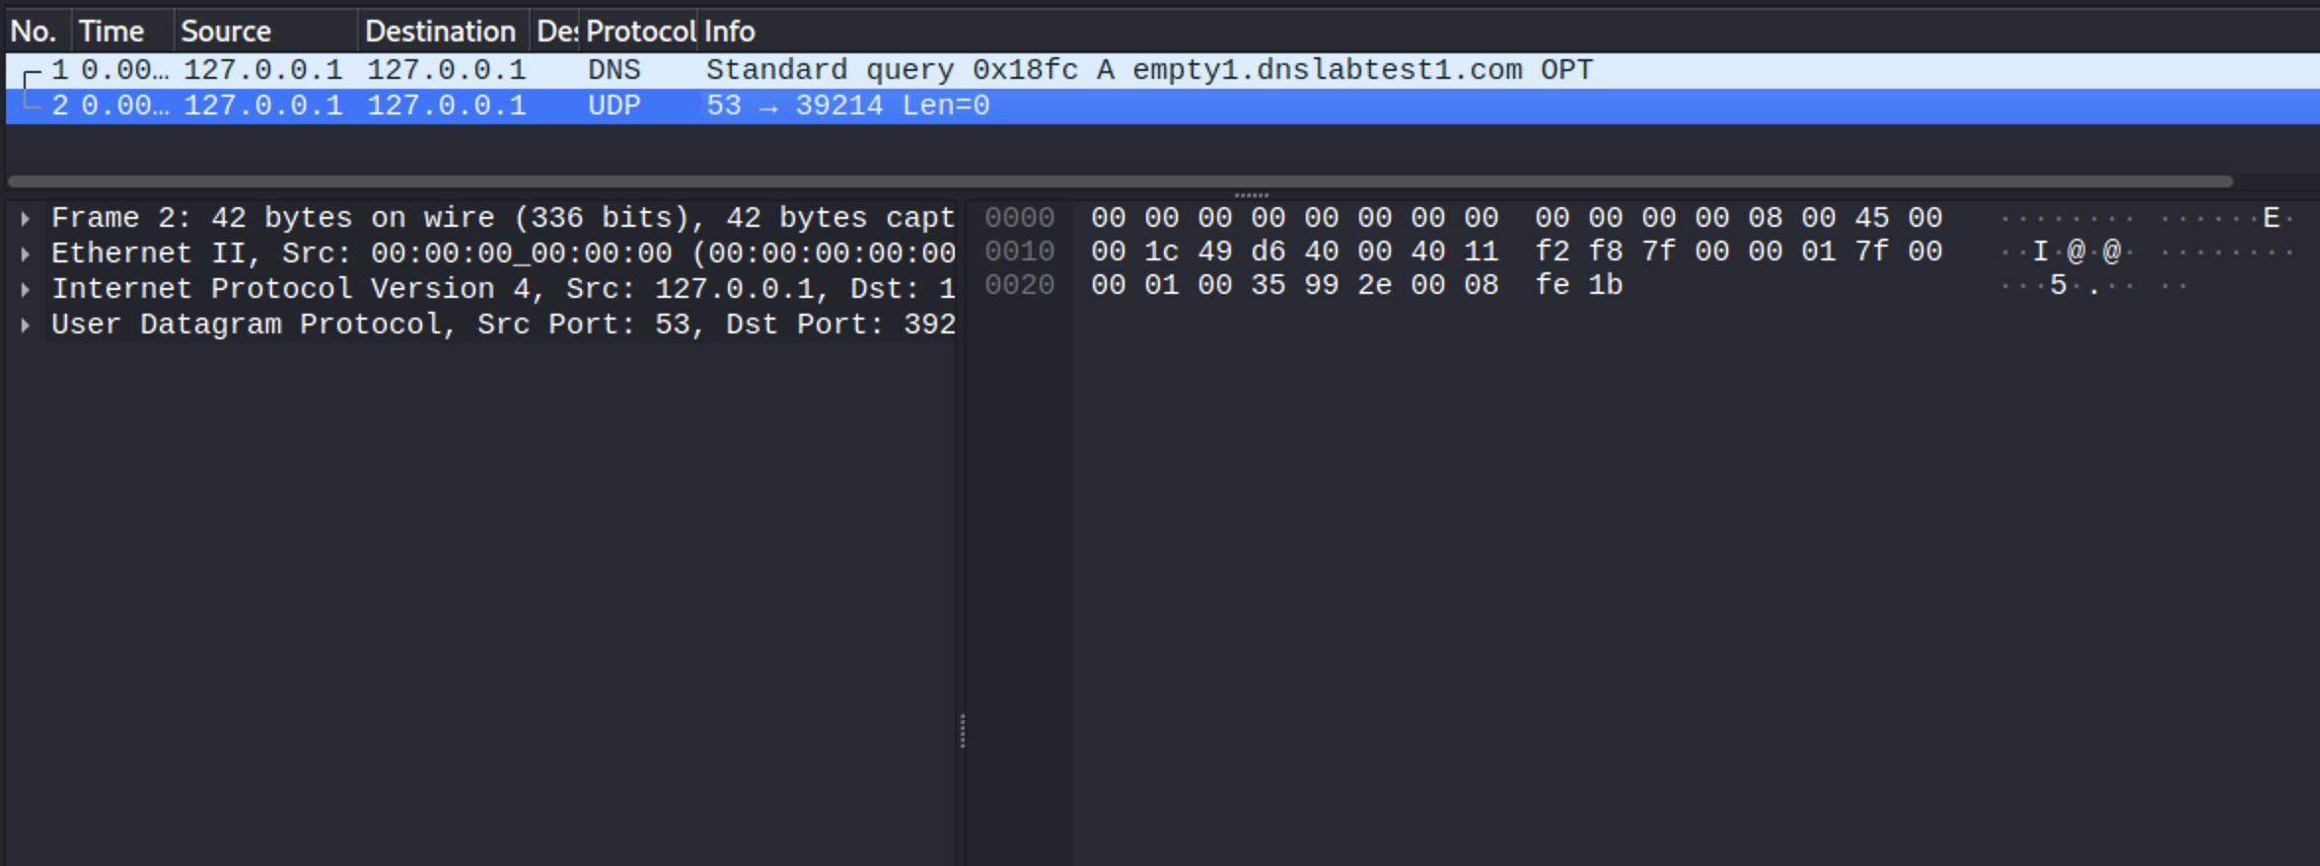
FUN WITH EMPTY RESPONSES
Could trigger a DoS for some servers

Slide 66
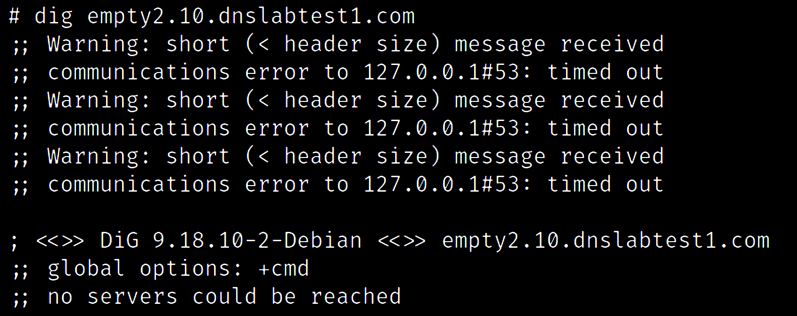
SENDING BACK NULL BYTES
Sending back 10 NULL bytes

Slide 67
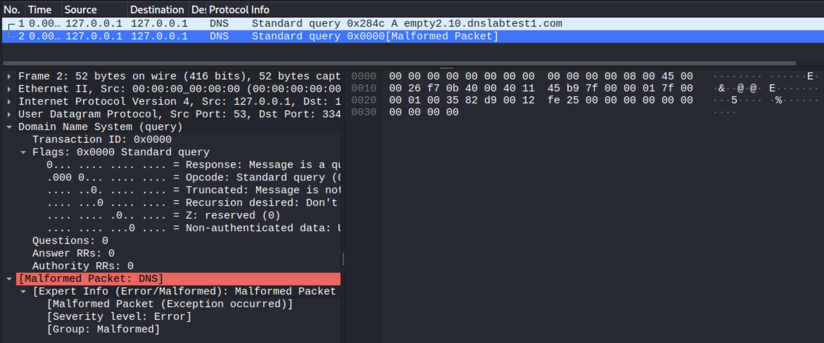
SENDING BACK NULL BYTES
Could trigger a DoS for some servers

Slide 68

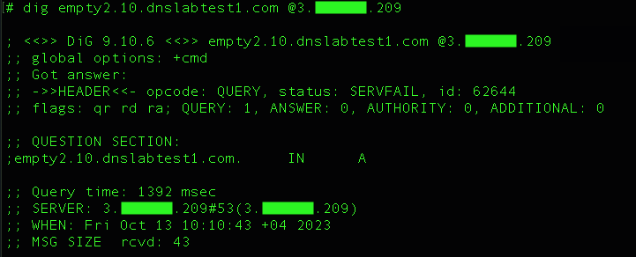
SENDING BACK NULL BYTES – KNOT RESOLVER
This is expected, but let’s see the PolarDNS console ..

Slide 69
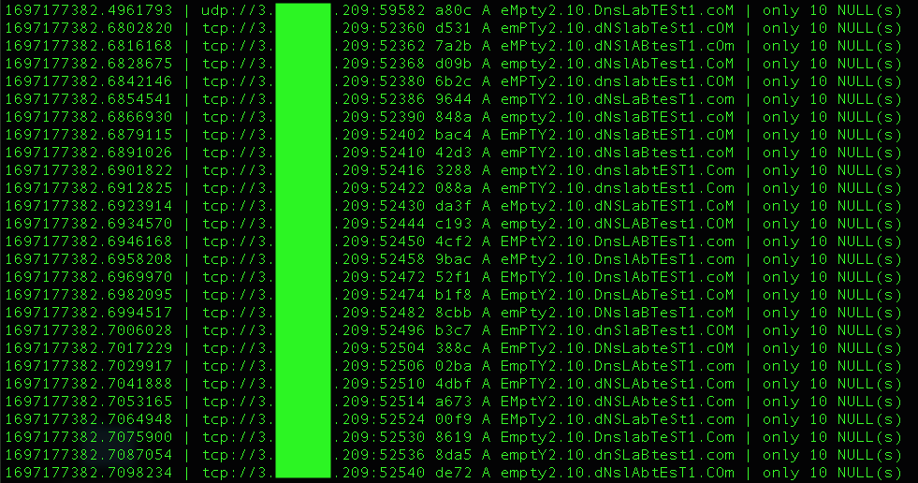
SENDING BACK NULL BYTES – KNOT RESOLVER
Timestamp | Source IP + port | ID | Incoming query | Our response
Knot Resolver is connecting to us very rapidly
It made nearly a 100 connections
Could be potentially abused as DoS
CVE-2023-46317

Slide 70
PLAYING WITH DOMAIN NAMES
In DNS, domain names are a tree structure.
DNS uses a special notation for transmitting domain names over the network called DNS name notation.
In this notation, each domain name is a sequence of labels where each label is prefixed by an octet (a byte) specifying number of characters in the label.

Slide 71
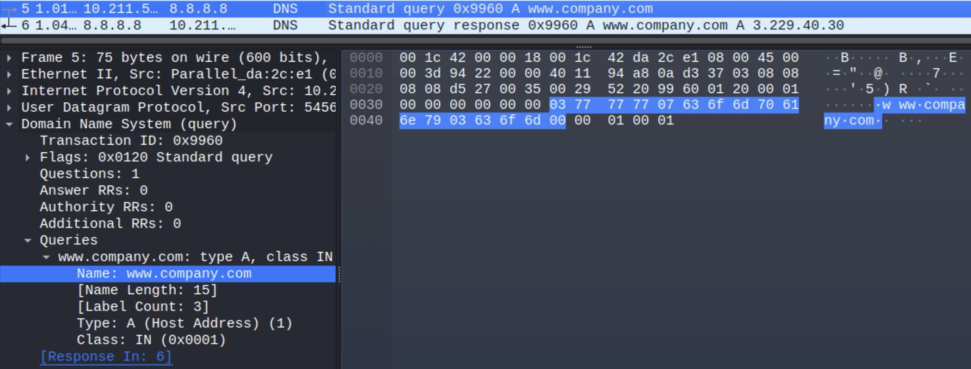
PLAYING WITH DOMAIN NAMES
www.company.com
(Human representation)
(Machine representation)
03 | 77 | 77 | 77 | 07 | 63 | 6f | 6d | 70 | 61 | 6e | 79 | 03 | 63 | 6f | 6d | 00
[3] | w | w | w | [7] | c | o | m | p | a | n | y | [3] | c | o | m | [0]
1 2 3 4
aka. DNS name notation

Slide 72
PLAYING WITH DOMAIN NAMES
www.company.com
DNS name notation
03 | 77 | 77 | 77 | 07 | 63 | 6f | 6d | 70 | 61 | 6e | 79 | 03 | 63 | 6f | 6d | 00
[3] | w | w | w | [7] | c | o | m | p | a | n | y | [3] | c | o | m | [0]
1 2 3 4
This represents the following 4 labels in the DNS tree structure:
1 2 3 4
Part
Label length
Label
Domain level
[3]www | [7]company | [3]com | [0]
3 | 7 | 3 | 0
www | company | com | ROOT
3 | 2 (SLD) | 1 (TLD) | 0

Slide 73


PLAYING WITH DOMAIN NAMES
www.company.com
DNS name notation
03 | 77 | 77 | 77 | 07 | 63 | 6f | 6d | 70 | 61 | 6e | 79 | 03 | 63 | 6f | 6d | 00
[3] | w | w | w | [7] | c | o | m | p | a | n | y | [3] | c | o | m | [0]
1 2 3 4
THERE ARE NO ACTUAL DOTS
HELLO
IN THE DOMAIN NAMES

Slide 74
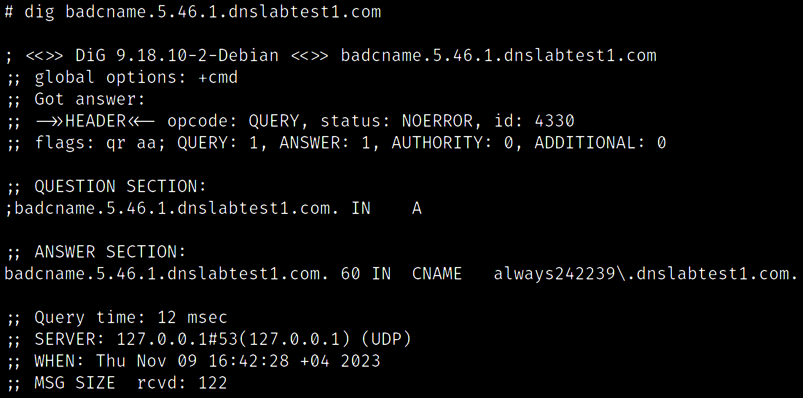
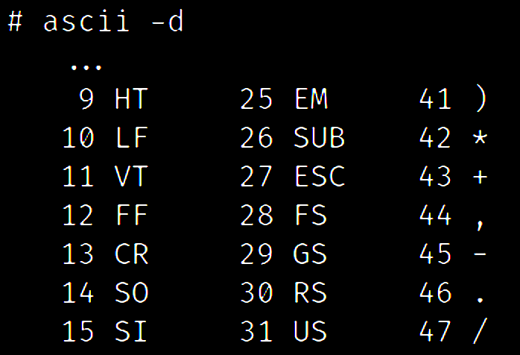
CNAME ALIAS WITH A DOT
position
byte
how many

Slide 75
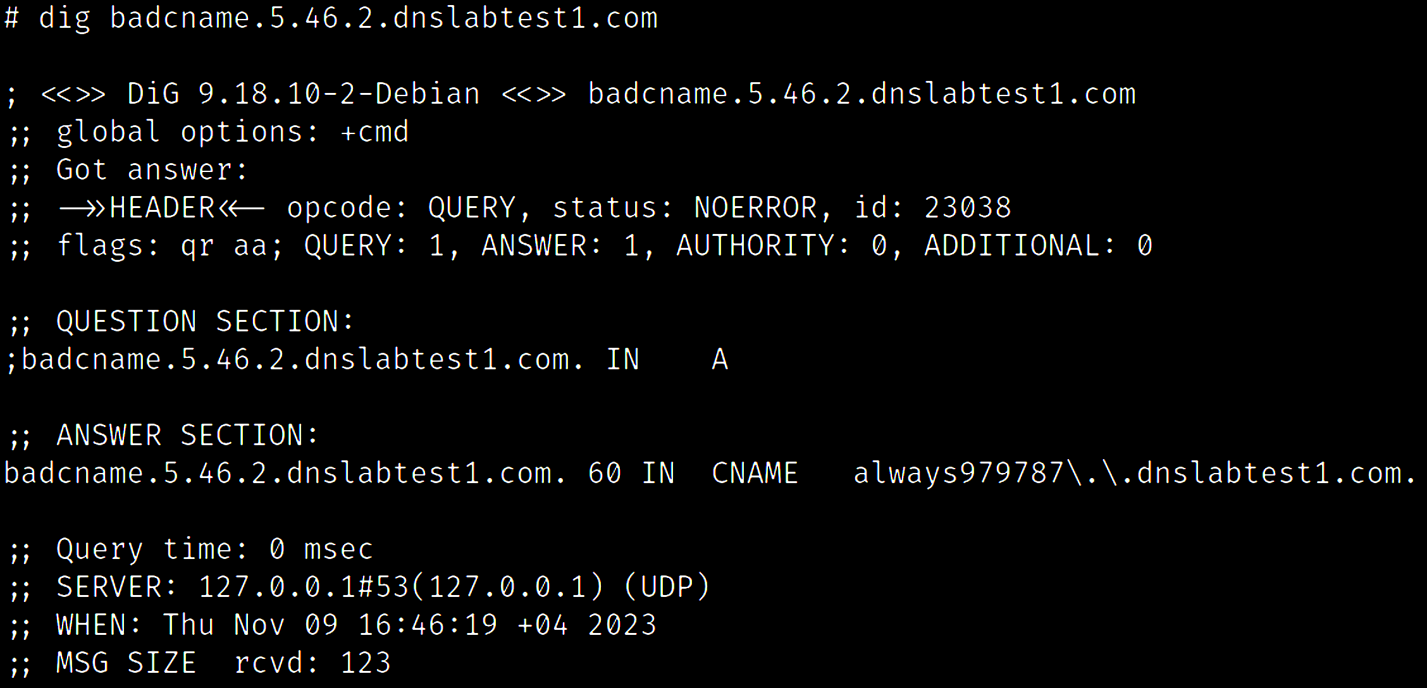
CNAME ALIAS WITH 2 DOTS

Slide 76
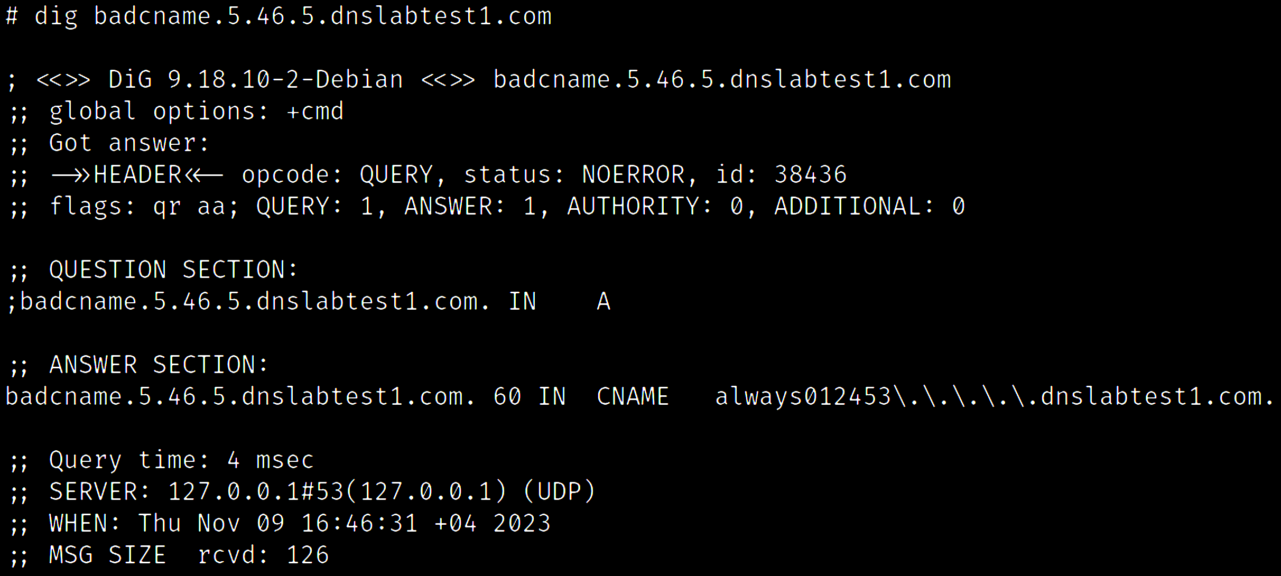
CNAME ALIAS WITH 5 DOTS

Slide 77
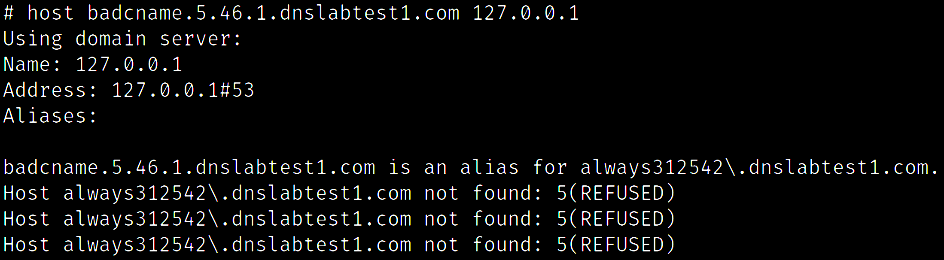
CNAME ALIAS WITH A DOT

Slide 78
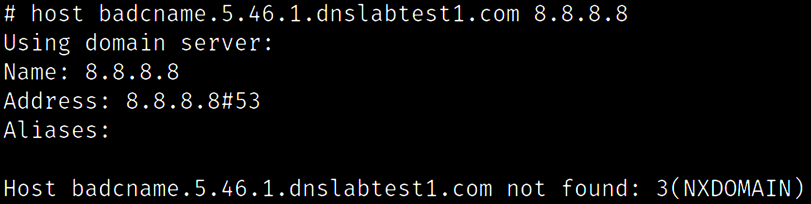
CNAME ALIAS WITH A DOT – GOOGLE DNS
Ok, expected

Slide 79

CNAME ALIAS WITH A DOT – CLOUDFLARE DNS
Ok, expected

Slide 80

CNAME ALIAS WITH A DOT – PROBLEMATIC RESOLVER
This DNS resolver is treating period as a label separator

Slide 81

CNAME ALIAS WITH 3 DOTS – PROBLEMATIC RESOLVER
Malformed hostnames coming from the target DNS resolver

Slide 82

CNAME ALIAS WITH 20 DOTS – PROBLEMATIC RESOLVER
Highly malformed response coming from the target DNS resolver
Promising target for further research

Slide 83
DOMAIN LOCK-UP ATTACKS
DoS vulnerabilities caused by deliberately misconfigured DNS servers
Aimed to “lock up” (occupy) a DNS resolver
Different variants and attack strategies

Slide 84
DOMAIN LOCK-UP VARIANT
Utilizing a long chain of CNAME aliases
1. chain1.malicious.com --> CNAME chain2.malicious.com
2. chain2.malicious.com --> CNAME chain3.malicious.com
3. chain3.malicious.com --> CNAME chain4.malicious.com
4. …
N. chain<N>.malicious.com --> CNAME chain<N+1>.malicious.com
Adding an extra delay before responding!

Slide 85


DOMAIN LOCK-UP VARIANT
Trigger the CNAME chain traversing
Target DNS resolver is traversing the CNAME chain deliberately slowly
Timestamp | Source IP + port | ID | Incoming query | Our response .
30 seconds spent .
traversing the chain .

Slide 86

DOMAIN LOCK-UP VARIANT
Scaling out ..
Now the DNS resolver has 100 running workers trying to resolve random chains
Sending 100 queries at once

Slide 87

DOMAIN LOCK-UP VARIANT
Health check of the target
DNS resolver
Sending 100 queries every second
DoS caused by 8.5 KB/s

Slide 88
FUN WITH TRANSACTION IDs

Slide 89

A NORMAL DNS QUERY AND RESPONSE
Transaction ID in the response must match the ID in the query

Slide 90
A NORMAL DNS QUERY AND RESPONSE
8.8.8.8
DNS query
example.com
2.
ID: 0x1234
DNS resolver
Authoritative DNS server
NS1
DNS response
3.
ID: 0x1234
Authoritative DNS server
NS2
DNS query
ID: 0x6d1a
HELLO AGAIN
1.
4.
DNS response
ID: 0x6d1a
Client

Slide 91
MISMATCHING TRANSACTION IDs
PolarDNS server has ability to replace the transaction ID in the response with a new random transaction ID
Include the ‘newid’ response modifier in the domain name e.g.:
anything.whatever.newid.attacker.com

Slide 92
MISMATCHING TRANSACTION IDs
8.8.8.8
DNS query
attacker.com
2.
ID: 0x1234
DNS resolver
NS1
DNS response
3.
?
ID: 0x1234
NS2
DNS query
ID: 0x5678
ID: 0x6d1a
1.
4.
The DNS resolver should not accept this response (3.)
?
Client

Slide 93

ID MISMATCH TEST
Ok, expected

Slide 94

ID MISMATCH TEST – GOOGLE DNS
Ok, expected

Slide 95

ID MISMATCH TEST – OPENDNS
Ok, expected

Slide 96

ID MISMATCH TEST – CLOUDFLARE DNS
???

Slide 97


LET’S ASK VARIOUS PUBLIC DNS RESOLVERS

Slide 98

ID MISMATCH TEST – ADGUARD DNS
???

Slide 99


MISMATCHING TRANSACTION IDs
CloudFlare and AdGuard do not care about transaction IDs at all !
Why is it important?

Slide 100
DNS CACHE POISONING
A caching DNS resolver is prone to cache poisoning if:
It uses predictable source ports (0-65535 / 16 bits)
It uses predictable transaction IDs (0-65535 / 16 bits)
Altogether, these 32 bits of supposedly random data present a complexity of 4,294,967,296 possible combinations (*).
==> VERY HARD / IMPOSSIBLE TO POISON
* Assuming the resolver is not using 0x20 encoding, DNS cookies etc.

Slide 101
DNS CACHE POISONING ON CLOUDFLARE AND ADGUARD
A caching DNS resolver is prone to cache poisoning if:
It uses predictable source ports (0-65535 / 16 bits)
It uses predictable transaction IDs (0-65535 / 16 bits)
Complexity is down to 65,536 possible combinations.
==> MUCH EASIER TO DO POISONING
Dan Kaminsky attack (2008)

Slide 102


BUG BOUNTY ON

Slide 103
CONCLUSION

Slide 104
CONCLUSION
There are many vulnerabilities on the server-side of DNS
Fruit might still be hanging low (!)
PolarDNS is a new testing tool in town for DNS server-side testing
Using a dedicated domain managed by PolarDNS presents a viable, practical environment suitable for DNS vulnerability research

Slide 105
CONCLUSION
With PolarDNS you can:
Experiment with the DNS protocol instantly, out-of-the-box
Implement your own ideas quickly, add interesting scenarios and PoCs without a need to implement your own DNS server
Find new vulnerabilities not just on the server-side of DNS

Slide 106
THANK YOU

Slide 107
THANK YOU

Slide 108
BONUS SLIDES

Slide 109

DNS COMPRESSION

Slide 110

DNS COMPRESSION
c0 = compression
Next byte (0c) is the offset from the beginning of the DNS packet referencing another string object.
0c = 12
It points to the first occurrence of “yahoo.com” string.

Slide 111
BAD DNS COMPRESSION
PolarDNS has multiple features related to compression which allow you for example:
Create compression loops (referencing to self, referencing to another string which references back)
Manipulate the compression offsets in different fields
Could lead to malformations and DoS issues

Slide 112

BAD DNS COMPRESSION
Malformed packet

Slide 113

BAD DNS COMPRESSION – VARIANT 1

Slide 114

BAD DNS COMPRESSION – VARIANT 2

Slide 115

BAD DNS COMPRESSION – VARIANT 3

